Slide 1
Motor Control

Slide 2
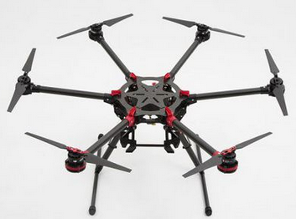
Motor Control
Multicopter consists of a multiple arms going from the center of multicopter and lying on the one plane. At the end of each arm there is a motor with propeller which can produce thrust in the direction aligned with this rotational axis.
By changing the speed of individual motors we can generate total thrust and torque and thus control the movement of the multicopter. So the only control input is array of speeds (or thrusts) of motors. The size of this array depends on the number of motors on the multicopter.

Slide 3
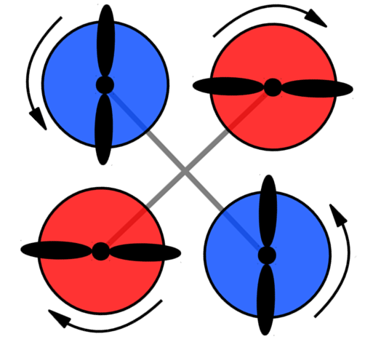
Yaw Rotation
Each of the rotors on the quad-copter produces both thrust and torque. Given that the front-left and rear-right motors both rotate counter-clockwise and the other two rotate clockwise, the net aerodynamic torque will be zero.

Slide 4
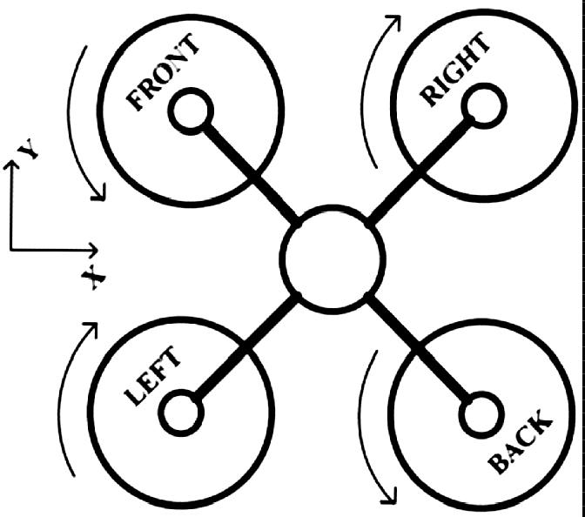
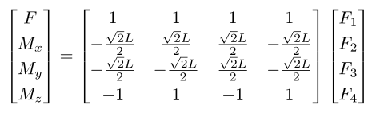
Model of Quad-copter
For a specific multicopter direct relationship between thrusts of propellers and total thrust and torque vector can be computed in a simple way.
where L is a length of arms, Fi is thrust of x-th propeller, F is a total thrust, Mi is torque around i-axis.

Slide 5
Task5
由四轴推算到六轴电机控制公式并应用

Slide 6
About Final Project
根据教务员的答复，成绩录入时间可以拖到下学期开学后，所以最后的Project开始提交时间为下学期开学第一天，截止时间为下学期开学后两个星期。具体日期到时候群上通知。
希望大家度过一个开心的暑假！

